Slide 1
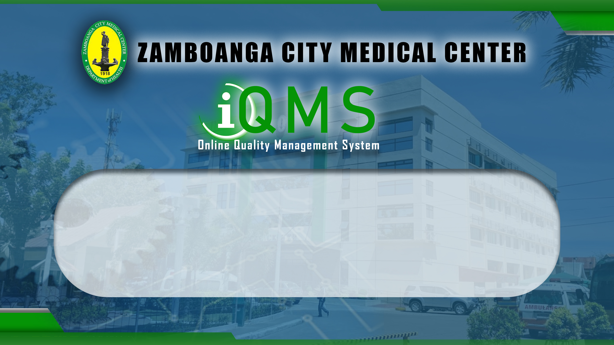
Procedure
Patient Management in the ER
Document Code: ZCMC | Revision No.: 0 | Date Effective: September 30, 2022

Slide 2
Quality Manual
TABLE OF CONTENTS
1. INTRODUCTION & SCOPE
2. VISION, MISSION, CORE VALUES, QUALITY POLICY
3. QMS MODEL

Slide 3
INTRODUCTION
QUALITY MANUAL
At Zamboanga City Medical Center, we know that quality management in patient service, training and research is an important step towards International Standard Organization (ISO) certification. We understand the road to realizing our dream of achieving a true quality management system for ZCMC is still long and laborious but given the commitment of the staff, the generous support of the top management and guidance of our consultant we will get there.
The Quality Management System (QMS) Manual specifies ISO 9001:2015 standards that ZCMC uses to address customer satisfaction, to satisfy customer and applicable requirements.
Main Menu

Slide 4
1.2 SCOPE OF THE QUALITY MANAGEMENT SYSTEM
QUALITY MANUAL
This QMS Manual specifies requirements for a quality management system of Intervention, Nursing Service Division in clinical areas, Nutrition and Dietetics, Pharmacy, Radiology, Laboratory, Rehabilitation, Central Supply & Sterilization (CSS), Medical Social Service (MSS), Hospital Operations and Patients Support Service (HOPSS), Finance Division, and Professional Education Training and Research Office (PET-RO) without applicability of design and development, clause 8.3.ZCMC on its provision applies from rendering Medical and Surgical
This also covers the identified internal and external issues including the needs and expectations of relevant interested parties. Refer to section clause 4.3 context of this manual.
Main Menu

Slide 5
1.3 OBJECTIVES OF THE QMS MANUAL
QUALITY MANUAL
This QMS manual serves as a guide and reference for all employees, and to provide a common understanding of the various medical center policies and procedures in the effective implementation and continual improvement of the quality management system established.
Main Menu

Slide 6
2.1 MEDICAL CENTER BACKGROUND
QUALITY MANUAL
The Zamboanga City Medical Center (ZCMC) was first established by the City’s Civil Government in 1918. Known before as Zamboanga General Hospital, the original structure included two Pavilions and the services limited to health education and medical treatment for contagious diseases. Thirteen years later a number of pavilions were constructed including the X-Ray and Laboratory Departments. The obstetrical Department at the same time was already recognized as a Special Unit.
The operations of the hospital were disrupted when Japanese Imperial Forces occupied Zamboanga City in 1942. It was then that the hospital was converted into a military headquarters and its health services transferred to another mission hospital –The Brent Hospital- which provided medical and health services to civilian and military personnel.
Main Menu
Page 6

Slide 7
2.1 MEDICAL CENTER BACKGROUND
QUALITY MANUAL
Normal operations resumed after the end of World War II in 1945. The hospital was in ruin and the prospect of rehabilitation was dim as there were other immediate priorities. It was only through the coordinated efforts of the community and the local government that made possible the reconstruction of the hospital’s facilities, subsequently restoring the provision of medical services.
It was in 1962 when the hospital was designated as a Training Center for Region VII, after which it was named Zamboanga Regional and Training Hospital after which it was designated as the Zamboanga Regional Hospital.
Main Menu

Slide 8
2.1 MEDICAL CENTER BACKGROUND
QUALITY MANUAL
On March 24, 1992 then President Corazon C. Aquino signed into law Republic Act No. 7272 converting the Zamboanga Regional Hospital into Zamboanga City Medical Center, which shall serve as the principal hospital facility of Region IX with a minimum bed capacity of two hundred fifty (250) under the jurisdiction of the DOH.
In January 2013, the ZCMC was licensed by the DOH and accredited by the Philippine Health Insurance Corporation (Philhealth) as a 300-bed capacity hospital. However, daily census of patients over the years has been increasing with bed occupancy rate ranging from 110-130% (330-390 inpatients per day), stretching the limits of available resources for ideal health care and compromising its efficiency.
On August 28, 2013, Republic Act 10613 was approved increasing the minimum bed capacity of ZCMC from two hundred fifty (250) to five hundred (500). Subsequently, A.O. 2014-0018 was signed by the Secretary of Health on May 29, 2014 Implementing Rules and Regulations of this Act.
Main Menu
Page 8

Slide 9
2.1 MEDICAL CENTER BACKGROUND
QUALITY MANUAL
The ZCMC is the only Level 3 General Service Training and Teaching Hospital in Zamboanga Peninsula Region. It is the end referral hospital of 26 infirmaries, 31 level 1 hospitals, and 8 level 2 hospitals in the Region and the ARMM provinces of Basilan, Sulu and Tawi-Tawi. However, patients needing specialized care that are not available in ZCMC are referred to medical center located on Davao, Cebu or Metro Manila.
With Department Order 2011-0188 “Kalusugan Pangkalahatan” Execution Plan and Implementation Arrangements”, the ZCMC is mandated to provide universal health care through its hospital services by increasing the number of its health human resources, improving its infrastructures, and upgrading its capabilities in terms of expertise, instruments and equipment.
Main Menu

Slide 10
2.1 MEDICAL CENTER BACKGROUND
QUALITY MANUAL
Under Department Order no. 2018-0096 “Functional Structure of DOH Units and Attached Agencies for the Implementation of FOURmula ONE for Health (F1) Plus” dated March 9, 2018 provides the functional arrangement among DOH units and its attached agencies for the implementation of F1 Plus. In the Philippine Health Agenda, the implementation mechanism known as the FOURmula ONE for Health (F1) Plus. aims to concentrate DOH resources towards the implementation of manageable interventions that are organized into the four components of the F1 Plus, namely: Financing; Service Delivery; Regulation; and, Governance. The “Plus” pertains to the incorporation of the Performance Governance System (PGS), which would enable DOH to objectively measure its performance for public accountability. Overall, F1 Plus provides the mechanism for efficient implementation of sector reform strategies as well as for ensuring accountability among DOH units and its attached agencies.
Main Menu

Slide 11
2.1 VISION, MISSION, CORE VALUES
QUALITY MANUAL
VISION
“ZCMC will be the APEX Multi-specialty Medical Center in Zamboanga Peninsula”
CORE VALUES
Compassion
Professionalism
Excellence
Safety
Culture/Gender Sensitivity
Holistic Approach
MISSION
“To provide affordable and accessible specialized health services, training and research through state-of-the-art technology in Zamboanga Peninsula in support of the Philippine Health Agenda”
Main Menu

Slide 12
2.4 QUALITY POLICY
QUALITY MANUAL
QUALITY POLICY
“We, the Zamboanga City Medical Center commit and ensure the highest standard of healthcare, satisfy applicable requirements and shall continually improve our quality management system for the satisfaction of our customer.”
Main Menu

Slide 13
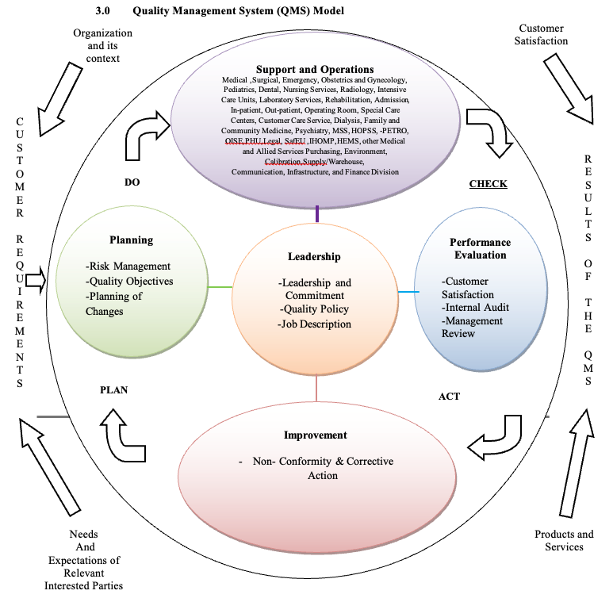
2.4 QUALITY POLICY
QUALITY MANUAL
Main Menu

Slide 14
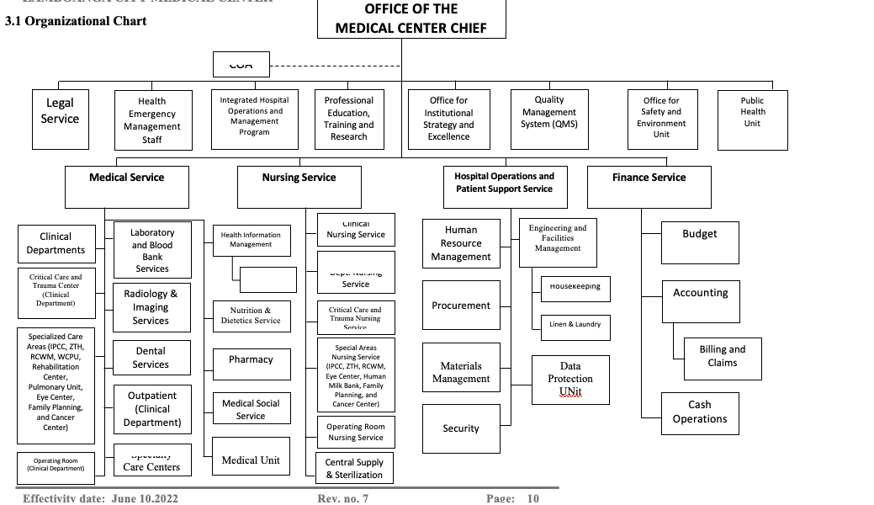
2.5 ORGANIZATIONAL CHART
QUALITY MANUAL
Main Menu

